Slide 1


CUSTOMER CARE REGISTRY
Empathy map

Slide 2

TEAM DETAILS
Team No : PNT2022TMID10794
College Name: IFET College of Engineering
Department : Electronic and communication Engineering
TEAM MEMBERS
VIGNESH D
YOGIRAMAN S
VIJAY K
HARSHAD SAI VENKAT
UDHAYANITHI

Slide 3
PROJECT DESIGN PHASE - 2
Empathy map
DATE | 8 November 2022
TEAM ID | PNT2022TMID10794
PROJECT NAME | CUSTOMER CARE REGISTRY
MAXIMUM MARKS | 2 Marks

Slide 4
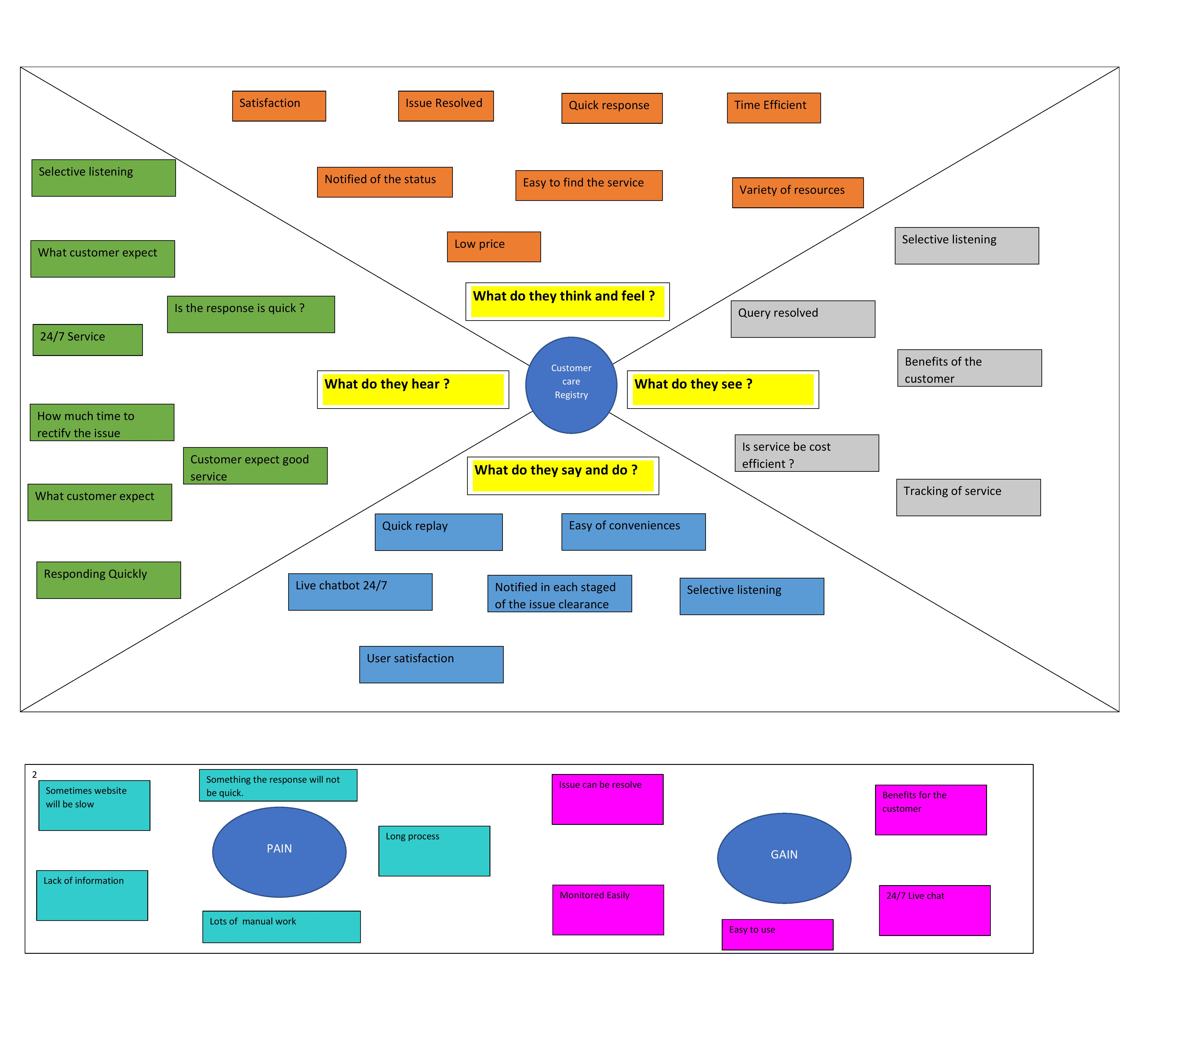
EMPATHY MAP

Slide 5

THANK
YOU

